Slide 1
Popular Programming Tech
Part 1
Introduction and Installation

Slide 2
Learning Objective
LO 1 : Explain fundamental concept of GO Programming Language

Slide 3
Outline
The origin of Go
Installation

Slide 4
The Origin of go

Slide 5
Preface
‘‘Go is an open source programming language that makes it easy to build simple, reliable, and efficient software.’’ (From the Go web site at golang.org)

Slide 6
History
Go was conceived in September 2007 by Robert Griesemer, Rob Pike, and Ken Thompson, all at Google, and was announced in November 2009. The goals of the language and its accompanying tools were to be expressive, efficient in both compilation and execution, and effective in writing reliable and robust programs.
Go bears a surface similarity to C and, like C, is a tool for professional programmers, achieving maximum effect with minimum means.
Go is especially well suited for building infrastructure like networked servers, and tools and systems for programmers, but it is truly a general-purpose language and finds use in domains as diverse as graphics, mobile applications, and machine learning

Slide 7
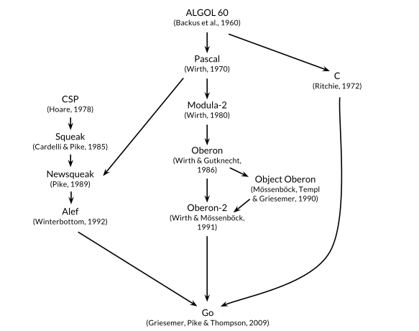

Slide 8
Installation (Windows)
Download GO: https://go.dev/doc/install
Open the MSI file you downloaded and follow the prompts to install Go.
By default, the installer will install Go to Program Files or Program Files (x86). You can change the location as needed. After installing, you will need to close and reopen any open command prompts so that changes to the environment made by the installer are reflected at the command prompt.

Slide 9
Installation (Mac)
Download: https://go.dev/dl/go1.19.2.darwin-amd64.pkg
Open the package file you downloaded and follow the prompts to install Go.
The package installs the Go distribution to /usr/local/go. The package should put the /usr/local/go/bin directory in your PATH environment variable. You may need to restart any open Terminal sessions for the change to take effect.

Slide 10
Installation (Linux)
Download: https://go.dev/dl/go1.19.2.linux-amd64.tar.gz
Remove any previous Go installation by deleting the /usr/local/go folder (if it exists), then extract the archive you just downloaded into /usr/local, creating a fresh Go tree in /usr/local/go:$ rm -rf /usr/local/go && tar -C /usr/local -xzf go1.19.2.linux-amd64.tar.gz
(You may need to run the command as root or through sudo).
Do not untar the archive into an existing /usr/local/go tree. This is known to produce broken Go installations.
Add /usr/local/go/bin to the PATH environment variable.
You can do this by adding the following line to your $HOME/.profile or /etc/profile (for a system-wide installation):
export PATH=$PATH:/usr/local/go/bin
Note: Changes made to a profile file may not apply until the next time you log into your computer. To apply the changes immediately, just run the shell commands directly or execute them from the profile using a command such as source $HOME/.profile.

Slide 11
Verifying
Verify that you've installed Go by opening a command prompt and typing the following command:
$ go version

Slide 12
References
https://go.dev/doc/install
How to Install Go on Windows? - GeeksforGeeks

